Slide 1

Mobile Computing Technology
February 5, 2025
Notes:
After the midterm

Slide 2
Kotlin
Conditional branching in

Slide 3
Kotlin
More of

Slide 4
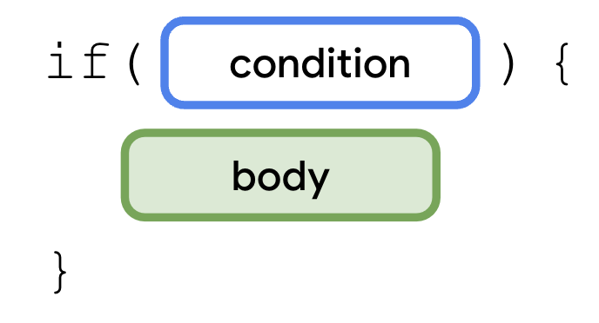

If-Statement
Notes:
An if statement starts with the if keyword followed by a condition, which is a boolean expression inside parentheses and a set of curly braces. The body is a series of statements or expressions that you put inside a pair of curly braces after the condition. These statements or expressions only execute when the condition is met. In other words, the statements within the curly braces only execute when a boolean expression in the if branch returns a true value.

Slide 5
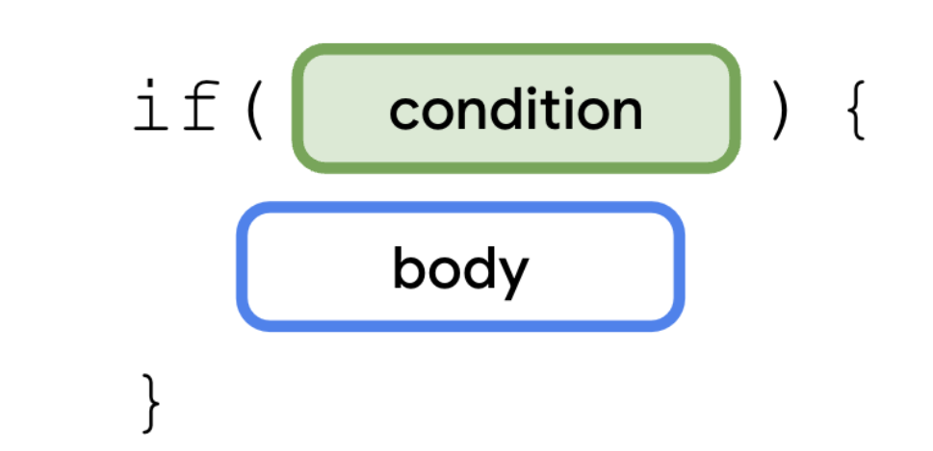


If-Statement
Use the if keyword followed by the condition that you want to evaluate.
You need to express the condition with a boolean expression.
Expressions combine values, variables, and operators that return a value.
Boolean expressions return a boolean value

Slide 6
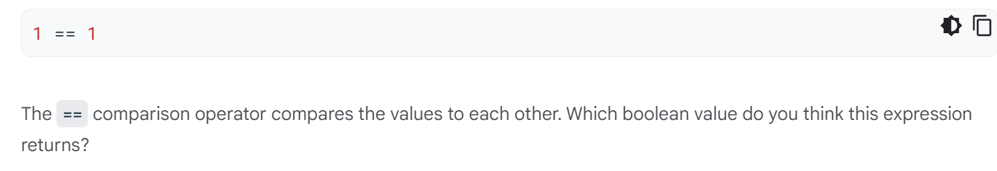
If-Statement

Slide 7
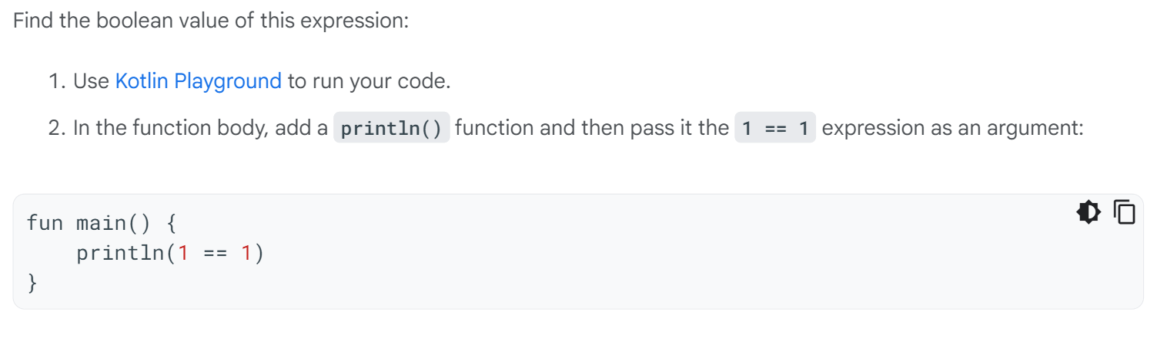
Comparison Operator

Slide 8
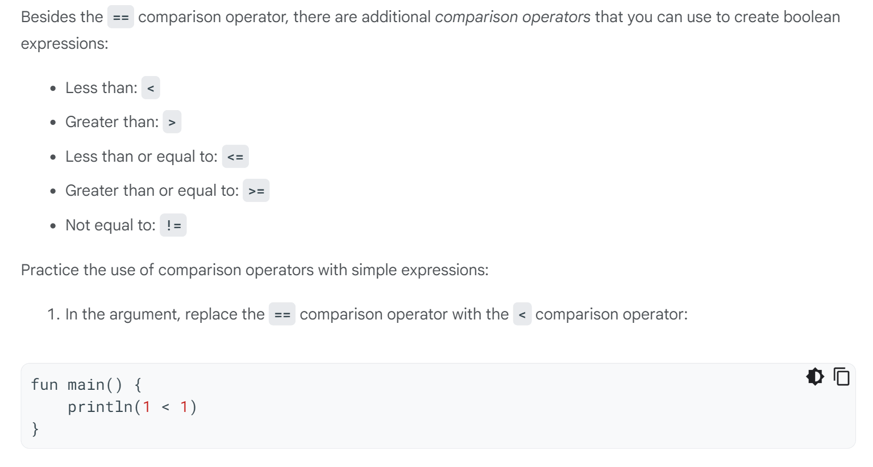

Boolean Operators

Slide 9
Boolean Operators

Slide 10
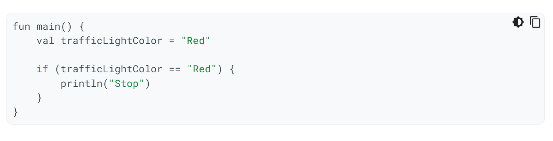
If-Statement: Try it
Notes:
An if statement starts with the if keyword followed by a condition, which is a boolean expression inside parentheses and a set of curly braces. The body is a series of statements or expressions that you put inside a pair of curly braces after the condition. These statements or expressions only execute when the condition is met. In other words, the statements within the curly braces only execute when a boolean expression in the if branch returns a true value.

Slide 11
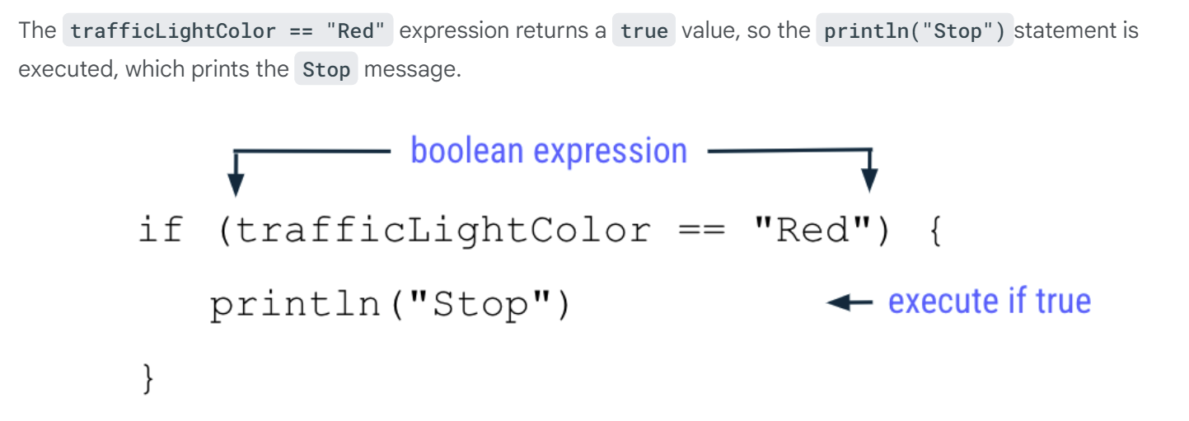
If-Statement
Notes:
An if statement starts with the if keyword followed by a condition, which is a boolean expression inside parentheses and a set of curly braces. The body is a series of statements or expressions that you put inside a pair of curly braces after the condition. These statements or expressions only execute when the condition is met. In other words, the statements within the curly braces only execute when a boolean expression in the if branch returns a true value.

Slide 12
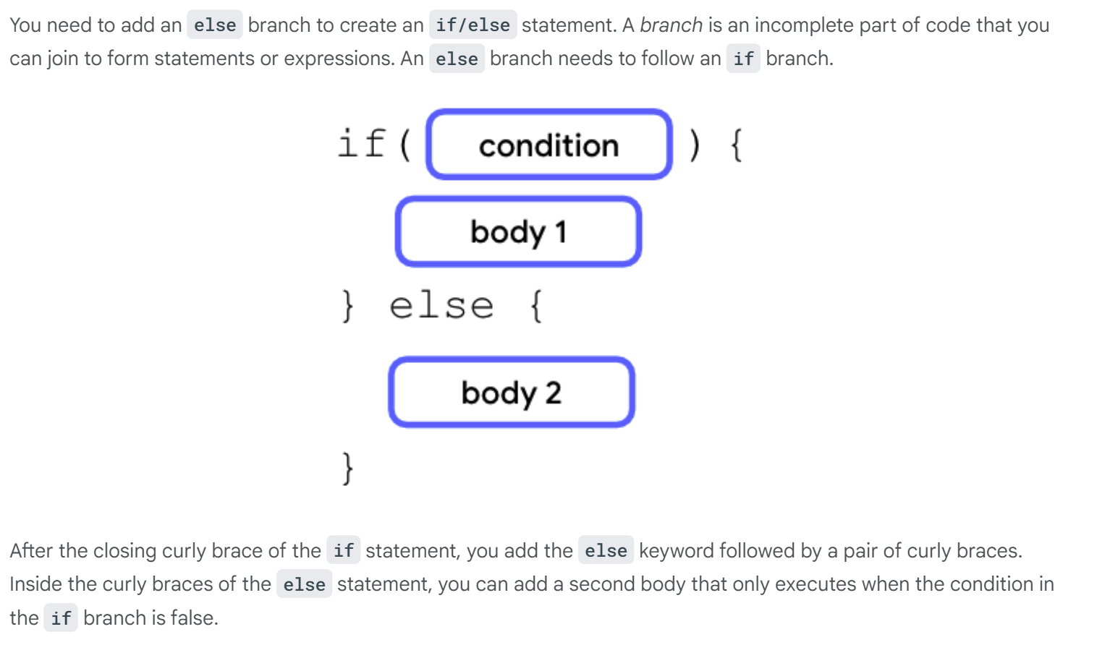

If-Else-Statement

Slide 13
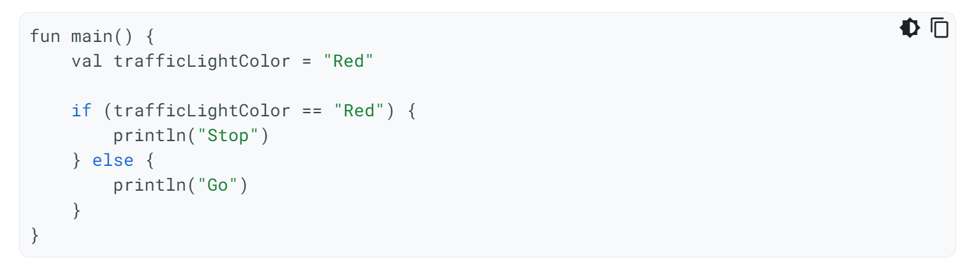
If-Else-Statement: Try it

Slide 14
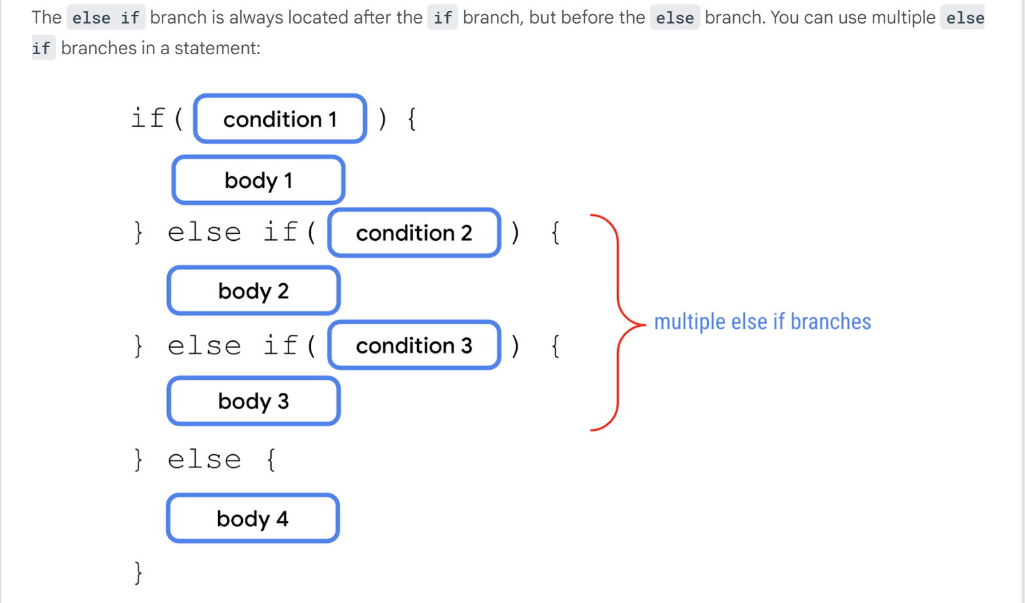

Else-If-Branch

Slide 15
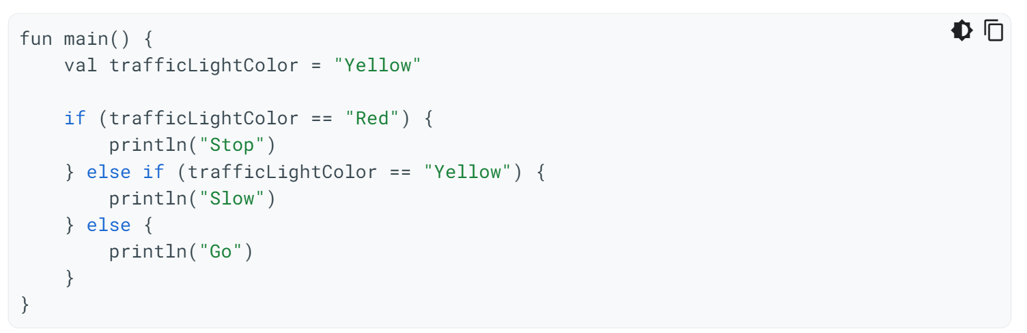
Else-If-Branch: Try it
Notes:
The body of else-if is only executed if condition 1 fails, but condition 2 is satisfied

Slide 16
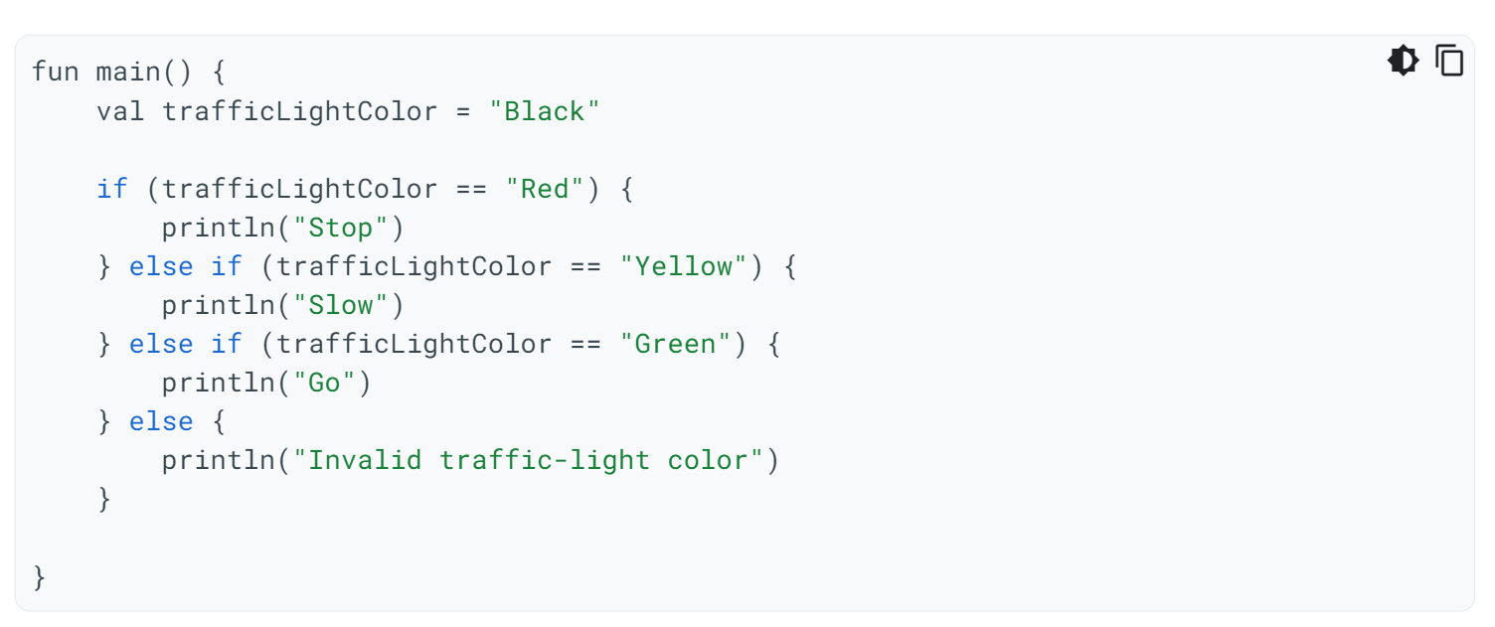

Else-If-Branch: Try it

Slide 17
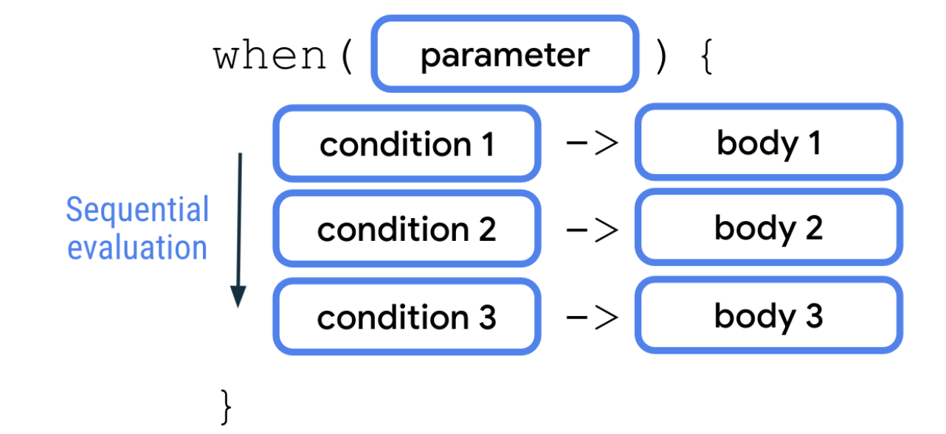
When-Statement
Notes:
In Kotlin, when you deal with multiple branches, you can use the when statement instead of the if/else statement because it improves readability, which refers to how easy it is for human readers, typically developers, to read the code. It's very important to consider readability when you write your code because it's likely that other developers need to review and modify your code throughout its lifetime. Good readability ensures that developers can correctly understand your code and don't inadvertently introduce bugs into it.
when statements are preferred when there are more than two branches to consider.

Slide 18
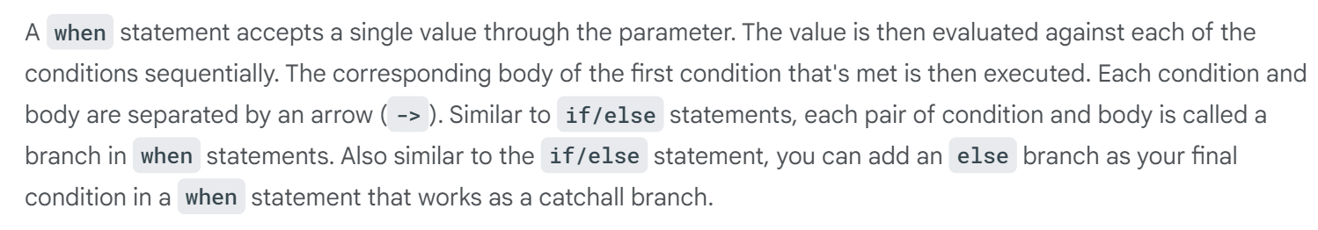
When-Statement

Slide 19
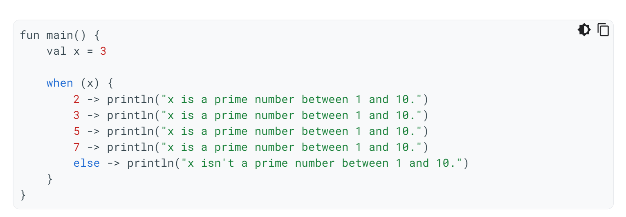
When-Statement: Try it
Notes:
Run the program and then verify that the output is as expected:
x is a prime number between 1 and 10.

Slide 20
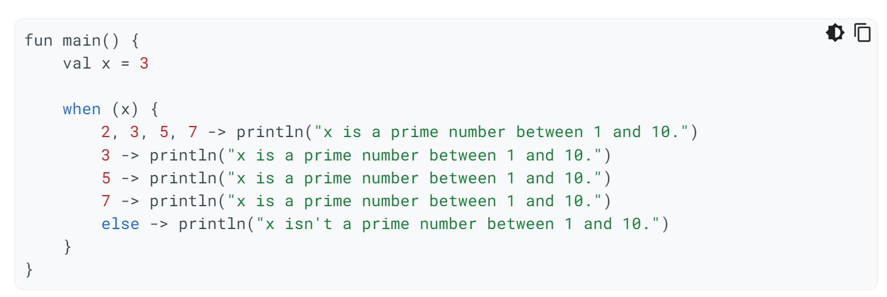
When-Statement: Try it
Notes:
Run the program and then verify that the output is as expected:
x is a prime number between 1 and 10.

Slide 21
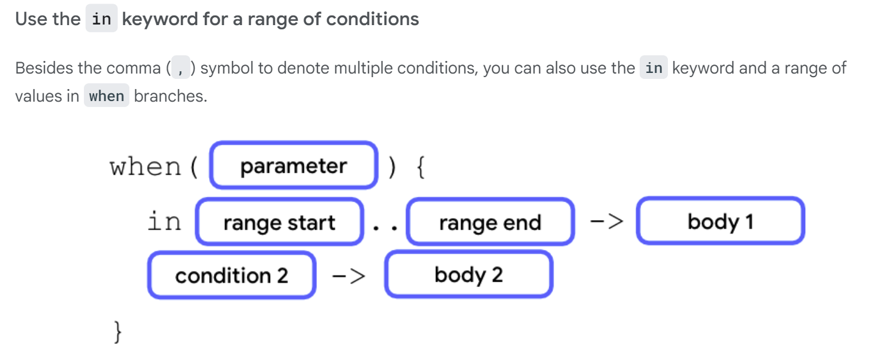
When-Statement
Notes:
To use a range of values, add a number that denotes the start of the range followed by two periods without any spaces and then close it with another number that denotes the end of the range.
When the value of the parameter is equal to any value in the range between start of the range and the end of the range, the first body executes.

Slide 22
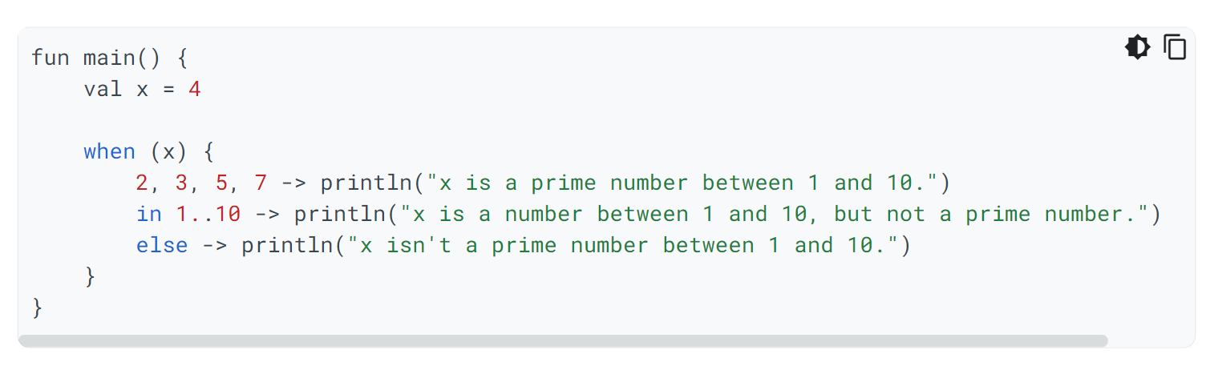
When-Statement: Try it
Notes:
Run the program and then verify the output:
x is a number between 1 and 10, but not a prime number.

Slide 23
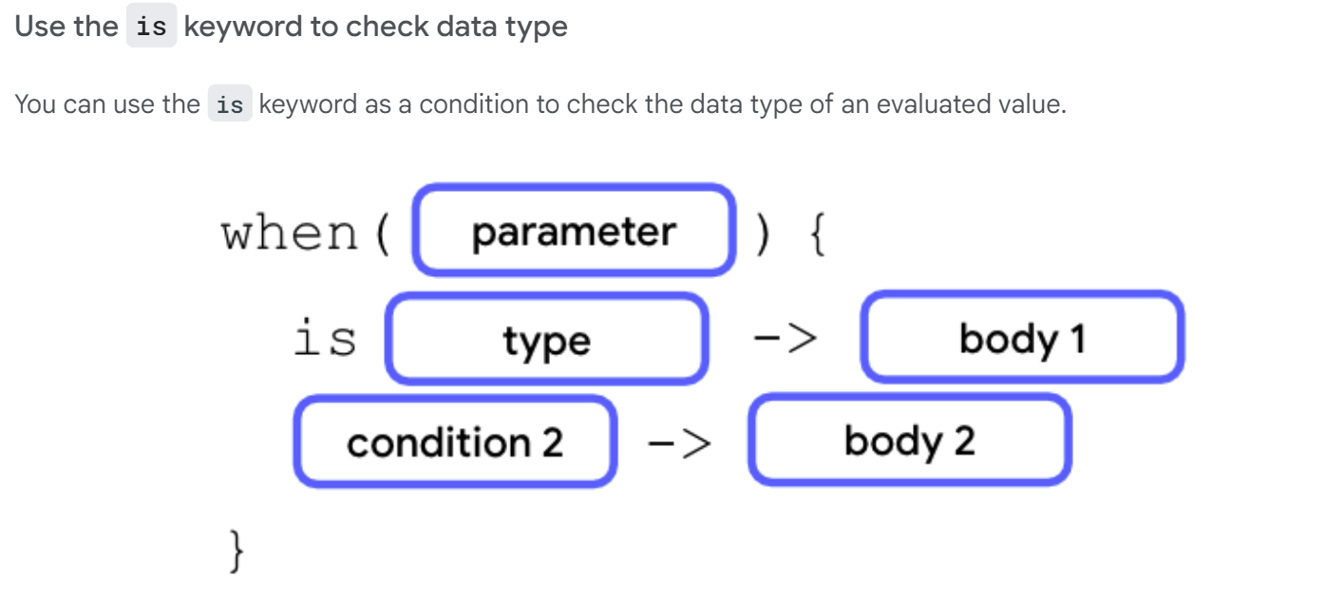
The is-keyword

Slide 24
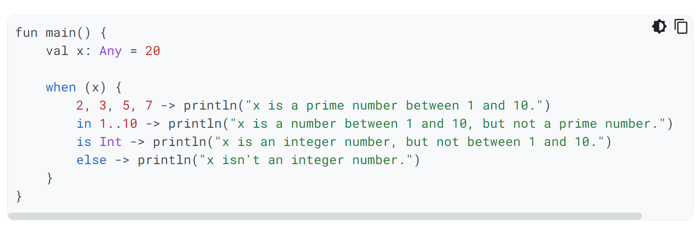
is-keyword: Try it

Slide 25
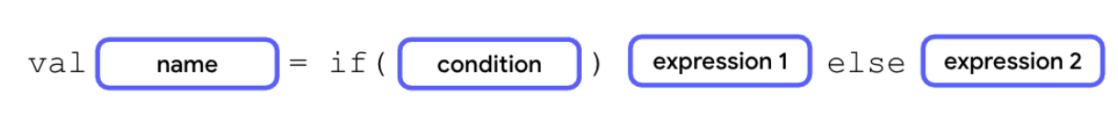

If-Else-Expression: Conditionals as expressions
Notes:
the last line of bodies in each branch need to return a value or an expression, and the conditionals are assigned to a variable.

Slide 26
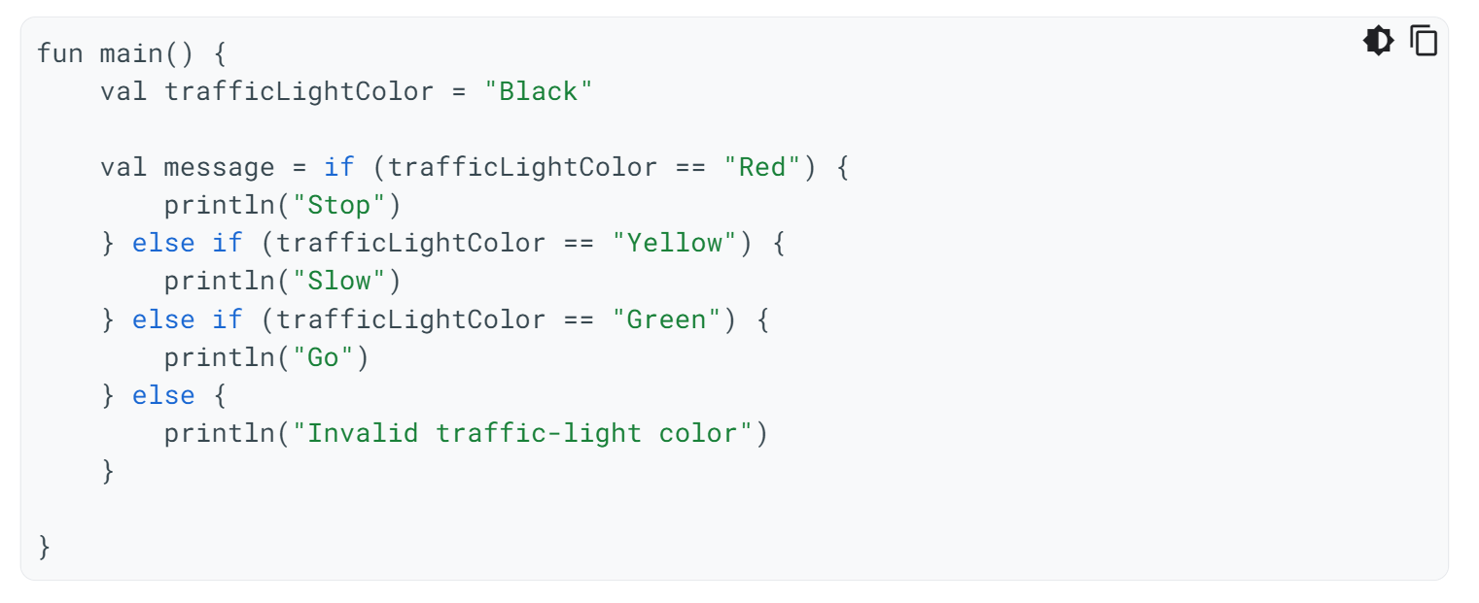
Conditionals as expressions: Try it
Notes:
the last line of bodies in each branch need to return a value or an expression, and the conditionals are assigned to a variable.

Slide 27
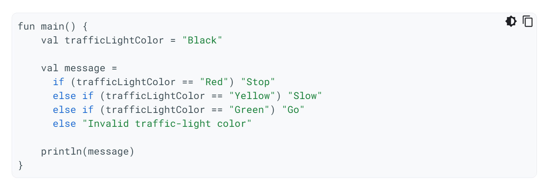
Conditionals as expressions: Try it
Notes:
the last line of bodies in each branch need to return a value or an expression, and the conditionals are assigned to a variable.

Slide 28
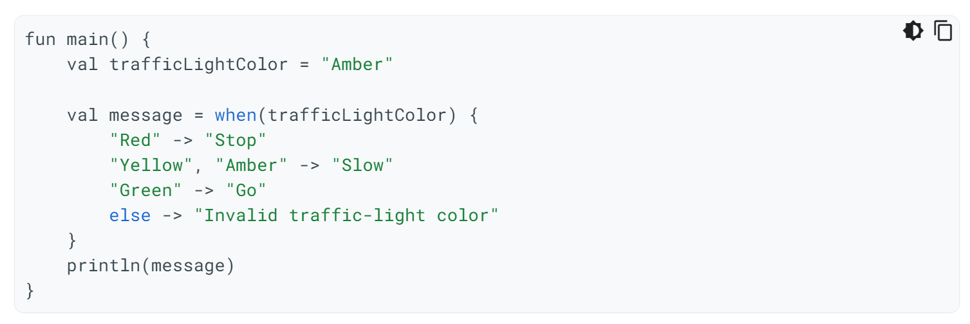
Conditionals as expressions: Try it

Slide 29
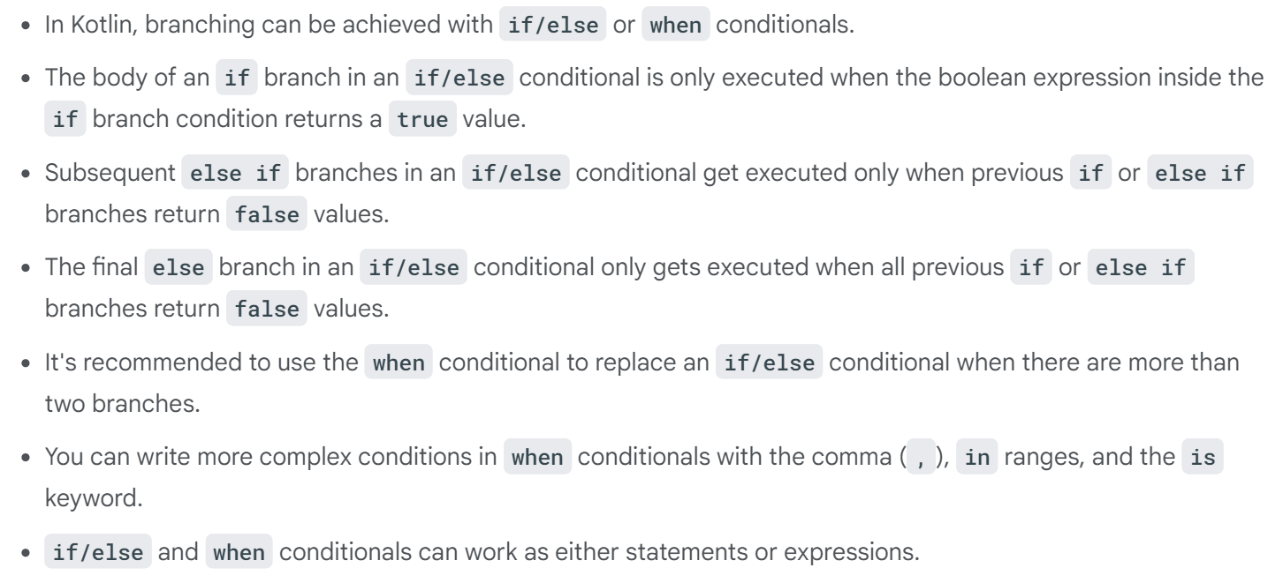

Summary

Slide 30
Mobile Computing Technology
March 10, 2025
Notes:
After the midterm

Slide 31
Sensors
How to use

Slide 32
Android Sensor Framework
The Android platform supports three broad categories of hardware-based as well as some virtual sensors:
Motion sensors
Measure acceleration forces and rotational forces along three axes.
accelerometers, gravity sensors, gyroscopes, and rotational vector sensors.
Environmental sensors
Measure various environmental parameters, such as ambient air temperature and pressure, illumination, and humidity.
barometers, photometers, and thermometers.
Position sensors
Measure the physical position of a device.
orientation sensors and magnetometers.
Notes:
Motion sensorsThese sensors measure acceleration forces and rotational forces along three axes. This category includes accelerometers, gravity sensors, gyroscopes, and rotational vector sensors.
Environmental sensorsThese sensors measure various environmental parameters, such as ambient air temperature and pressure, illumination, and humidity. This category includes barometers, photometers, and thermometers.
Position sensorsThese sensors measure the physical position of a device. This category includes orientation sensors and magnetometers.
Hardware-based sensors are physical components built into a handset or tablet device. They derive their data by directly measuring specific environmental properties, such as acceleration, geomagnetic field strength, or angular change. Software-based sensors are not physical devices, although they mimic hardware-based sensors. Software-based sensors derive their data from one or more of the hardware-based sensors and are sometimes called virtual sensors or synthetic sensors. The linear acceleration sensor and the gravity sensor are examples of software-based sensors.
https://developer.android.com/develop/sensors-and-location/sensors/sensors_overview

Slide 33
Android Sensor Framework
The Android platform provides
Access to sensors available on the device to acquire raw sensor data
Several classes and interfaces to do the following:
Determine which sensors are available on a device.
Determine an individual sensor's capabilities, such as its maximum range, manufacturer, power requirements, and resolution.
Acquire raw sensor data and define the minimum rate at which you acquire sensor data.
Register and unregister sensor event listeners that monitor sensor changes.
Notes:
https://developer.android.com/develop/sensors-and-location/sensors/sensors_overview
You can access sensors available on the device and acquire raw sensor data by using the Android sensor framework. The sensor framework provides several classes and interfaces that help you perform a wide variety of sensor-related tasks. For example, you can use the sensor framework to do the following:
Determine which sensors are available on a device.
you may want to identify all of the sensors that are present on a device and disable any application features that rely on sensors that are not present. Likewise, you may want to identify all of the sensors of a given type so you can choose the sensor implementation that has the optimum performance for your application.
Determine an individual sensor's capabilities, such as its maximum range, manufacturer, power requirements, and resolution.
Acquire raw sensor data and define the minimum rate at which you acquire sensor data.
Register and unregister sensor event listeners that monitor sensor changes.
Monitoring sensor events is how you acquire raw sensor data. A sensor event occurs every time a sensor detects a change in the parameters it is measuring. A sensor event provides you with four pieces of information: the name of the sensor that triggered the event, the timestamp for the event, the accuracy of the event, and the raw sensor data that triggered the event.
Android-powered devices may have a few type of sensor, however, typically not all type of Android sensors listed above. For example, most handset devices and tablets have an accelerometer and a magnetometer, but fewer devices have barometers or thermometers. Also, a device can have more than one sensor of a given type. For example, a device can have two gravity sensors, each one having a different range.

Slide 34
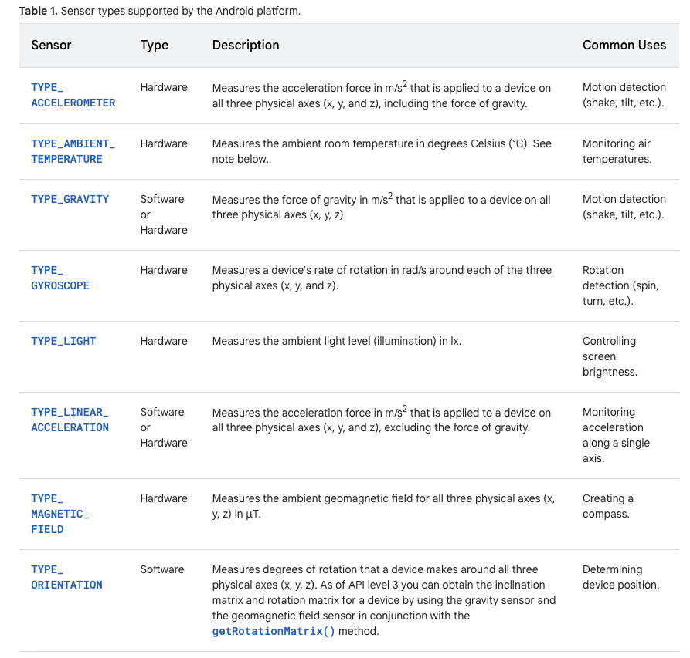
Android Sensor Framework
Notes:
https://developer.android.com/develop/sensors-and-location/sensors/sensors_overview
Android-powered devices may have a few type of sensor, however, typically not all type of Android sensors listed above. For example, most handset devices and tablets have an accelerometer and a magnetometer, but fewer devices have barometers or thermometers. Also, a device can have more than one sensor of a given type. For example, a device can have two gravity sensors, each one having a different range.

Slide 35
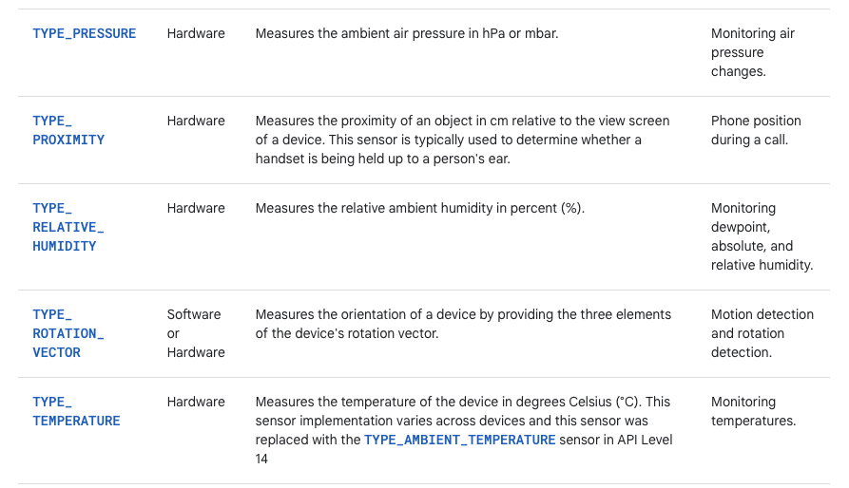
Android Sensor Framework
Notes:
https://developer.android.com/develop/sensors-and-location/sensors/sensors_overview

Slide 36
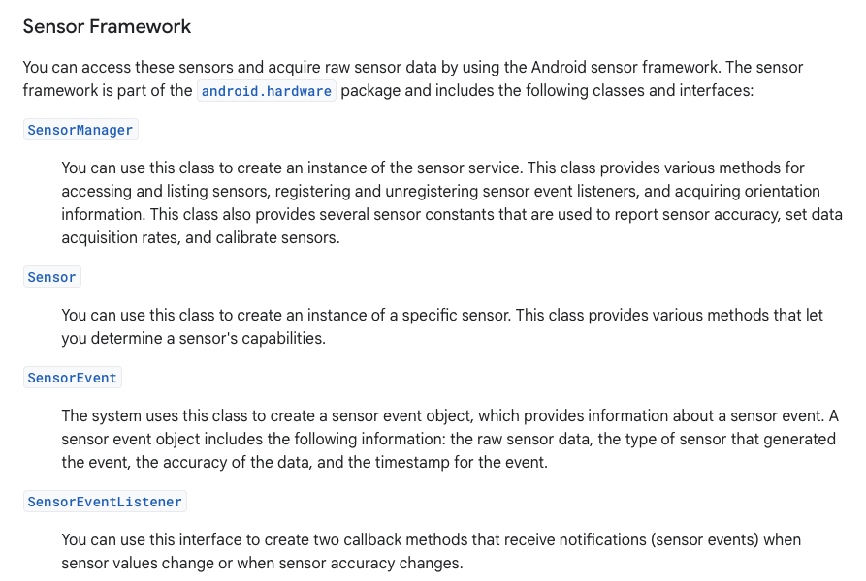
Android Sensor Framework
Notes:
https://developer.android.com/develop/sensors-and-location/sensors/sensors_overview
Question: What information does a SensorEvent object include? A SensorEvent object contains information about the new sensor data, including: the accuracy of the data, the sensor that generated the data, the timestamp at which the data was generated, and the new data that the sensor recorded.
Question: Which callback methods can you register for a sensor?
onSensorChanged() to receive notifications (sensor events) when sensor values change. The system invokes this method providing you with a reference to the Sensor object that changed and the new accuracy of the sensor. Accuracy is represented by one of four status constants: SENSOR_STATUS_ACCURACY_LOW, SENSOR_STATUS_ACCURACY_MEDIUM,SENSOR_STATUS_ACCURACY_HIG, or SENSOR_STATUS_UNRELIABLE.
onAccuracyChanged() to receive notifications when sensor accuracy changes. The system invokes this method providing you with a SensorEvent object.
ToDo: Run the example code. In the instruction
val deviceSensors: List<Sensor> = sensorManager.getSensorList(Sensor.TYPE_ALL)
change the type of the sensor from TYPE_GRAVITY
ToDo: If you already know about UML, you could draw a class diagram showing the associations between the above classes
The required information can be extracted from the text

Slide 37
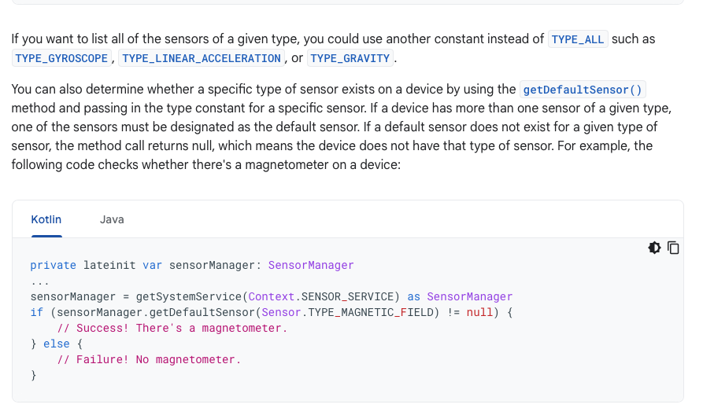
Android Sensor Framework

Slide 38
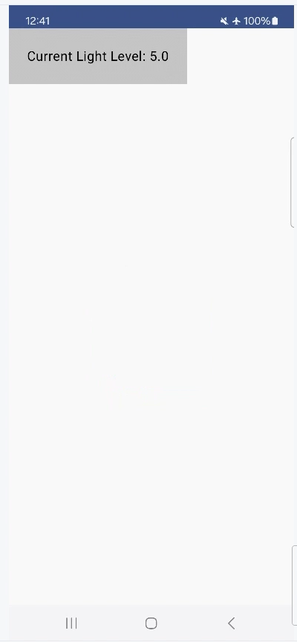
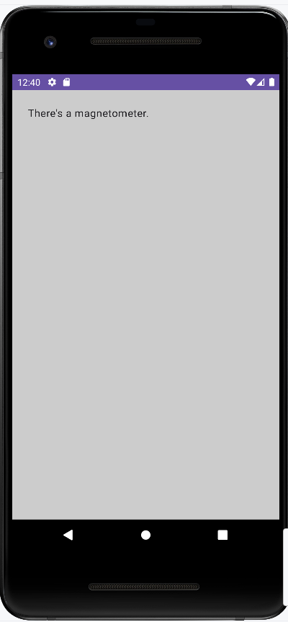
Android Sensor Framework
ToDo
Create a project in Android Studio using the attached code
Build and run the app
Determine:
What type of data does your proximity sensor provide? Binary ( "near" or "far"), numerical, ordinal?
Compare results with other students
Change the output text
Replace proximity sensor with temperature sensor
Notes:
package com.example.exercise1 import android.content.Context import android.hardware.Sensor import android.hardware.SensorEvent import android.hardware.SensorEventListener import android.hardware.SensorManager import android.os.Bundle import androidx.activity.ComponentActivity import androidx.activity.compose.setContent import androidx.compose.foundation.layout.fillMaxSize import androidx.compose.foundation.layout.padding import androidx.compose.material3.MaterialTheme import androidx.compose.material3.Surface import androidx.compose.material3.Text import androidx.compose.runtime.Composable import androidx.compose.ui.Modifier import androidx.compose.ui.graphics.Color import androidx.compose.ui.unit.dp import com.example.exercise1.ui.theme.Exercise1Theme class MainActivity : ComponentActivity(), SensorEventListener { // To identify the sensors that are on a device you first need // to get a reference to the sensor service. To do this, you create // an instance of the SensorManager class // by calling the getSystemService() method and passing in the SENSOR_SERVICE argument. private lateinit var sensorManager: SensorManager private var myMessage: String = "Nothing" private var myLight: Sensor? = null private var myProximitySensor: Sensor? = null // EventHandler; The entry point to this Android app override fun onCreate(savedInstanceState: Bundle?) { super.onCreate(savedInstanceState) sensorManager = getSystemService(Context.SENSOR_SERVICE) as SensorManager myLight = sensorManager.getDefaultSensor(Sensor.TYPE_LIGHT) myProximitySensor = sensorManager.getDefaultSensor(Sensor.TYPE_PROXIMITY) myMessage = if (sensorManager.getDefaultSensor(Sensor.TYPE_MAGNETIC_FIELD) != null) { "There's a magnetometer.\n" } else { "No magnetometer.\n" } setContent { // All functions marked with the @Composable annotation can be called // from the setContent() function or from other Composable functions. // The @Composable annotation tells // the Kotlin compiler that this function is used by Jetpack Compose to generate the UI. Exercise1Theme { // A surface container using the 'background' color from the theme Surface(modifier = Modifier.fillMaxSize(), color = MaterialTheme.colorScheme.background) { Greeting(myMessage) //Greeting(myLight.toString()) } } } } override fun onAccuracyChanged(sensor: Sensor, accuracy: Int) { // Do something here if sensor accuracy changes. } override fun onSensorChanged(event: SensorEvent) { if (event.sensor.type == Sensor.TYPE_LIGHT) { val mLightLevel = event.values[0] myMessage = "Current Light Level: $mLightLevel" } else if (event.sensor.type == Sensor.TYPE_PROXIMITY) { val mProximity = event.values[0] myMessage = buildString { append("\nProximity: ") append(mProximity.toString()) } } setContent { Exercise1Theme { Greeting(myMessage) } } } override fun onResume() { // Register a listener for the sensor. super.onResume() myLight?.also { myLight -> sensorManager.registerListener(this, myLight, SensorManager.SENSOR_DELAY_UI) } myProximitySensor?.also { myProximitySensor -> sensorManager.registerListener(this, myProximitySensor, SensorManager.SENSOR_DELAY_FASTEST) } } override fun onPause() { // Be sure to unregister the sensor when the activity pauses. super.onPause() sensorManager.unregisterListener(this) } } // A Modifier is used to augment or decorate a composable. // One modifier you can use is the padding modifier, // which adds space around the element (in this case, adding space around the text). // This is accomplished by using the Modifier.padding() function. @Composable fun Greeting(name: String) { Surface(color = Color.LightGray){ Text( text = name, modifier = Modifier.padding(24.dp) ) } }

